Slide 1
GROWING MICHIGAN’S GOOD FOOD FUTURE.
Notes:
Welcome

Slide 2
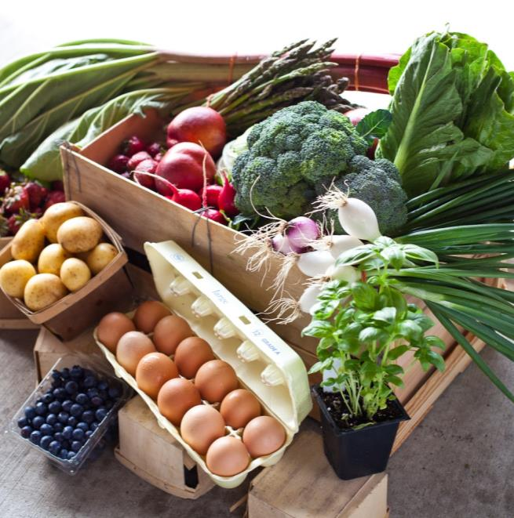
MICHIGAN GOOD FOOD FUND About the Fund
A public-private partnership $30M loan fund that provides financing & business assistance to good food enterprises that benefit underserved communities across Michigan.
Notes:
MI Good Food Fund, a new public-private partnership loan and grant fund that provides financing and business assistance to good food enterprises that benefit underserved communities across Michigan.

Slide 3
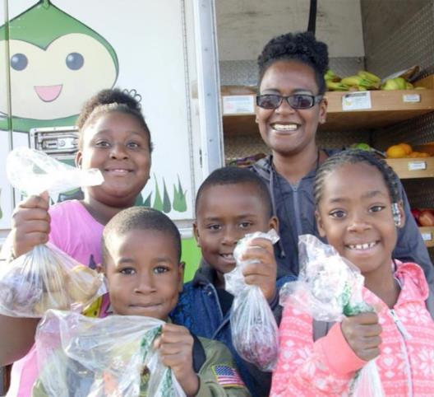
MICHIGAN GOOD FOOD FUND Why it Matters
1.8 + million Michigan residents — including 300,000 children — live in lower-income communities with limited healthy food access.
Notes:
We believe an investment in good food is an investment in our future.
This is particularly true in Michigan which is the second most agriculturally diverse state in the nation.
Food and agriculture are major drivers of our state’s economy, contributing $101.2 billion annually.
Yet despite this abundance, more than 1.8 million Michigan residents—including 300,000 children—live in lower-income communities with limited access to the healthy fruits and vegetables they need (1).
It doesn’t add up.
Sources:
1: AHA Food For Every Child Report. Source: Population in low-income, low-supermarket tracts. Derived from: Nielsen TDLinx Data (2014). American Community Survey 2008–2012, 2014 ESRI Data & Maps

Slide 4
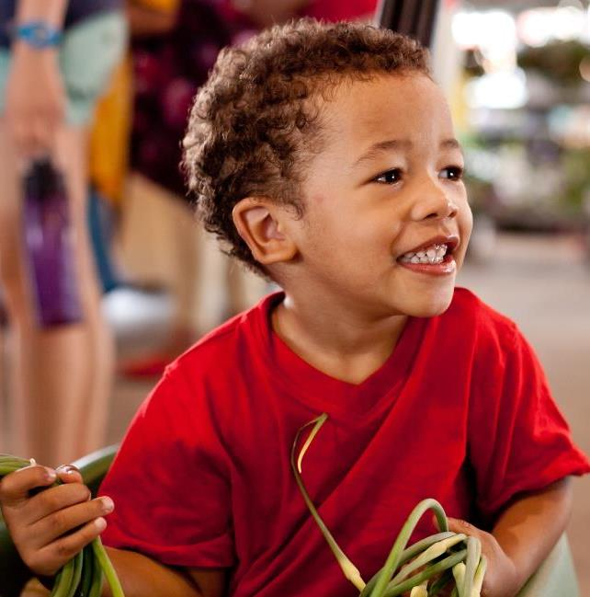
MICHIGAN GOOD FOOD FUND Why it Matters
Lack of access to healthy food has serious health implications:
More than 30% of Michiganders are obese
Disproportionately impacts communities of color.
Obesity costs the state $3 billion annually in related medical expenses.
Notes:
Lack of access to healthy food has serious health implications.
More than 30% of Michiganders are obese—the second highest rate of obesity in the Midwest. (1)
This is not a rural or urban issue but something that impacts places across our state. (2)
Communities of color bear a disproportionate burden. (3)
Also has serious economic impact. Michigan currently spends $3 billion annually on obesity-related medical expenses. (4)
Sources:
1: The Robert Wood Johnson Foundation and Trust for America’s Health (2014). The State of Obesity: Better Policies for a Healthier America, p. 10. Retrieved from: http://stateofobesity.org/files/stateofobesity2014.pdf)
2: AHA report
3: Source: Michigan Department of Community Health (2009). Michigan Behavioral Factor Surveillance System (BRFSS). Retrieved from: http://www.michigan.gov/brfs
4:A Special Message from Governor Rick Snyder: Health and Wellness (2011). www.michigan.gov. Retrieved from: http://crcmich.org/PUBLICAT/2010s/2014/rpt387.pdf

Slide 5
THE FUND RESPONDS TO THESE CHALLENGES WITH A FINANCING OPPORTUNITY.
Notes:
The MI Good Food Fund responds to these challenges with a financing opportunity.

Slide 6
MICHIGAN GOOD FOOD FUND Goals & Priorities
Goals & Priorities
Increase access to healthy food
Drive economic development & job creation
By Promoting
Racial and Social Equity
Environmental Stewardship
Local sourcing
Notes:
By supporting healthy food entrepreneurs in our state, we aim to increase access to healthy food and drive economic development and jo
Specifically, the Michigan Good Food Fund is working to advance the following goals and priorities:
- Increase access to healthy food as a means to improve the health of all Michigan residents.
- Drive economic development and job creation to grow Michigan’s economy.
By promoting:
- Racial and Social Equity: Ensure equitable access to food, jobs, ownership, and flexible investment capital.
- Environmental Stewardship: Encourage sustainable environmental practices.
- Local Sourcing: Increase the sourcing and supply of locally grown and regionally produced foods.
b creation, while also promoting Racial and Social Equity, Environmental Stewardship, and Local Sourcing.

Slide 7
HEALTHY FOOD FINANCING A Proven Strategy
 | State / Place | Size
California FreshWorks Fund | CA | $272 M
Cincinnati Fresh Food Financing Fund | Cincinnati, OH | $15 M
Colorado Fresh Food Financing Initiative | CO | $10 M
Illinois Fresh Food Fund | IL | $10 M
New Jersey Food Access Initiative | NJ | $19 M
New York Healthy Food, Healthy Communities Initiative | NY | $30 M
New Orleans Fresh Food Retailer Initiative | New Orleans, LA | $14 M
Pennsylvania Fresh Food Financing Initiative | PA | $120 M
Virginia Fresh Food Loan Fund | VA | $11 M
Notes:
Healthy food financing is a proven strategy.
The Michigan Good Food Fund was initiated in 2012 with a $3 million federal Healthy Food Financing Initiative award to Capital Impact Partners for use in Michigan.
The fund is modeled after the pioneering Pennsylvania Fresh Food Financing Initiative, as well as other successful statewide healthy food financing efforts including the California FreshWorks Fund, the Illinois Fresh Food Fund, and the Virginia Fresh Food Loan Fund.

Slide 8
HEALTHY FOOD FINANCING A Proven Strategy
PA Fresh Food Financing
88 new or expanded stores led to 5,000 jobs, increasing access for nearly 500,000 people.
California FreshWorks
3 retail locations led to $40 million initial economic impact with expected $30 million annual recurring impact.
Notes:
These other healthy food financing efforts have demonstrated significant impact to date:
Pennsylvania: The healthy food financing campaign in Pennsylvania resulted in 88 new or expanded grocery stores, created 5,000 jobs, and increased healthy food access for nearly 500,000 people.
California: Based on the evaluation completed for California FreshWorks, which included three retail locations, the approximately $20 million initial investment in those three retailers led to an estimated $40 million of initial economic impact with an expected $30 million annual recurring impact, based on an economic multiplier model.

Slide 9
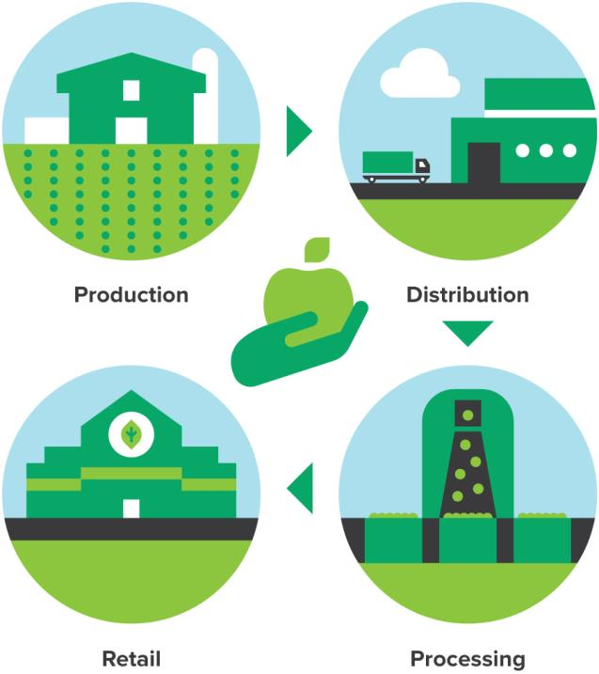
MICHIGAN GOOD FOOD FUND A Unique Strategy
We’re strengthening Michigan’s Good Food Chain — from field to fork.
Notes:
But MGFF is unique compared to other HFFI efforts. 3 defining attributes
1: Working across the value chain. We’re committed to strengthening Michigan’s entire good food chain. That’s why unlike other healthy food financing efforts, we’re supporting efforts from field to fork including the enterprises that grow, distribute, and sell fresh and healthy food that reaches low-income populations. This is a first of its kind approach working to create financial and social impact throughout the food supply chain.

Slide 10
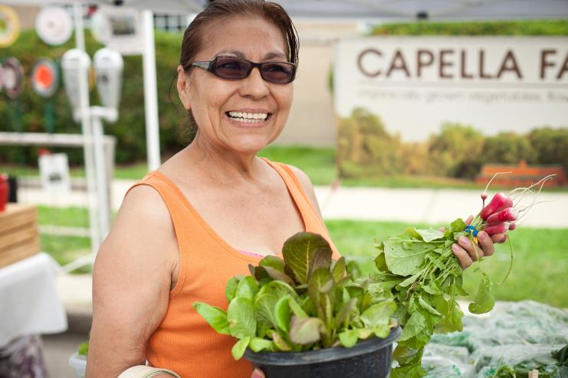
MICHIGAN GOOD FOOD FUND A Unique Strategy
Focus on racial & social equity to ensure the fund benefits underserved residents.
Notes:
2. Serious focus on racial and social equity.
This means ensuring that supported projects benefit historically underserved communities in terms of greater access to healthy food, jobs, and economic benefits, while also ensuring that we serve those projects often overlooked by traditional financing sources.

Slide 11
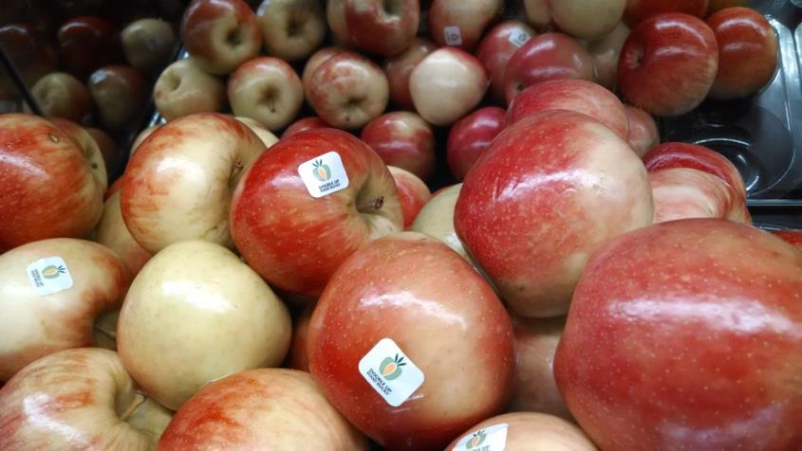
MICHIGAN GOOD FOOD FUND A Unique Strategy
Leverage unique assets in Michigan from Michigan Good Food Charter to Double Up Food Bucks.
Notes:
Leverage unique assets in MI:
Grounded in the goals of the MI Good Food Charter and supports progress toward its goal that 20% of food consumed in MI is grown in MI by 2020.
Working to ensure integration of Double Up Food Bucks in supported retail projects.

Slide 12
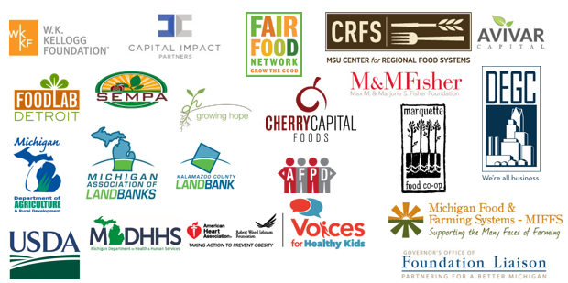
MICHIGAN GOOD FOOD FUND Advisory Council Partners
Notes:
In addition to leveraging our state’s robust infrastructure and capacity, the fund’s creation and ongoing support are made possible by a broad coalition of industry, nonprofit, higher education, government, and philanthropic partners.
Specifically, an Advisory Council was developed to inform the design and execution of the Fund. This is a diverse community of organizations and institutions working together to transform communities across our state into places of opportunity. You can see some of the partners here – all listed on the Fund’s website.

Slide 13
MICHIGAN GOOD FOOD FUND Core Fund Partners
Capital Impact Partners
Fund manager
Fair Food Network
Communications
Pipeline & Business Assistance: Retail & Small-batch processing projects
MSU Center for Regional Food Systems
Pipeline & Business Assistance: Agricultural production, aggregation, distribution & processing projects
W.K. Kellogg Foundation
Fund supporter & investor
Notes:
The fund’s management and execution is led by 4 core partners. This includes:
Capital Impact Partners, a nonprofit certified Community Development Financial Institution with a 30-year history lending to projects in underserved communities, manages the fund. capitalimpact.org
Fair Food Network, a Michigan-based national nonprofit committed to pioneering solutions that support farmers, strengthen local economies, and increase access to healthy food, is leading outreach and communications. It also provides business assistance and pipeline development for retail and small-batch processing projects. fairfoodnetwork.org
Michigan State University Center for Regional Food Systems is a research, outreach, and education organization that is leading business assistance and pipeline development for agricultural production, aggregation and distribution, as well as processing projects. foodsystems.msu.edu
W.K. Kellogg Foundation is one of the fund’s supporters and investors.

Slide 14
MICHIGAN GOOD FOOD FUND Financing
$30 Million Available
Loans
$250K+ managed by Capital Impact
Under $250K managed by intermediaries
New Market Tax Credits
For projects larger than $5 million
Notes:
Want to dig in and share more specifics about the fund.
First: Financing
We know every project is different, so from loans to facilitating new market tax credits, we offer multiple financing options to meet the needs of the enterprises we serve. Our lending approach is mission-driven. As such, we are willing to invest in projects often overlooked by traditional sources of financing.

Slide 15
MICHIGAN GOOD FOOD FUND Business Assistance
Michigan Good Food Fund is providing a range of business assistance to help entrepreneurs take their ventures to the next level and prepare for financing.
Notes:
Lending is be bolstered by business assistance services to help entrepreneurs take their ventures to the next level and build a pipeline of investment-ready enterprises.

Slide 16
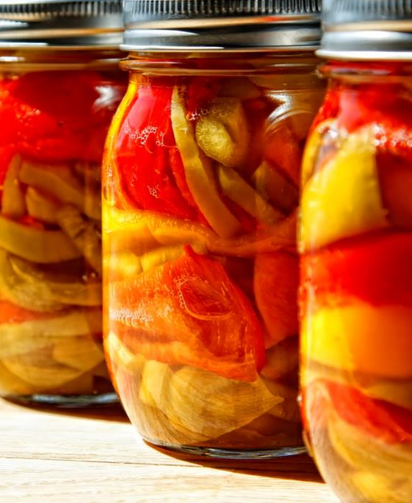
MICHIGAN GOOD FOOD FUND Business Assistance
What types of business assistance is available?
Consulting Network:
One-on-one support to better prepare projects for financing.
Courses:
Bodega Bootcamp
Business Bootcamp
Webinars & Workshops on product positioning, food & safety, licensing, etc.
Notes:
What type of support is available?
1-1 Consulting Support
And online and in- person Courses, includes boot camps, webinars, workshops

Slide 17
BUSINESS ASSISTANCE Consulting Network
The Fund is building a statewide wide network of preferred consultants.
Consultants are identified and vetted for expertise in a variety of areas: financial management, business planning, food safety compliance, licensing, retail/grocery operations, logistics management, marketing, product packaging, and more.
We match enterprises with consultants for 1:1 business assistance.
We also tap this network to provide training and facilitation for specific workshops and bootcamps.

Slide 18
ELIGIBILITY OF APPLICANTS
Notes:
Let’s talk about eligibility.

Slide 19
MICHIGAN GOOD FOOD FUND Eligibility: Entities
What types of entities does the Fund support?
Existing enterprises that want to expand their businesses.
For-profits
Nonprofit organizations
Cooperatives (open to the public without requiring membership or non-exclusive membership)
Notes:
Eligible applicants must meet key criteria shaped around Fund goals.
Entities must be existing businesses, in operating, and generating revenue. Can be a For-profit (corporation, LLC, L3C, sole proprietor, or partnership); Nonprofit; or Cooperative (open to the public without requiring a membership or non-exclusive membership cooperatives)

Slide 20
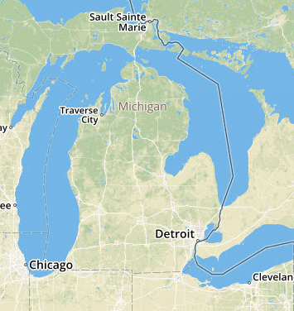
MICHIGAN GOOD FOOD FUND Eligibility: Location
What type of locations must be served?
Locations within or serving Michigan
AND
Within low or moderate income census tracts or tracts with limited access to healthy foods, and/or serving such communities.
Notes:
Location: Entities are located within or serving MI within low to moderate income census tracts.

Slide 21
MICHIGAN GOOD FOOD FUND Eligibility: Projects
What types of projects does the Fund support?
Projects across the food value chain that increase access to food that is healthy, green, fair, and affordable.
Production
Processing
Aggregation / Distribution
Retail
Notes:
Projects: Activities supported by the fund can fall into one of five categories:
Supplies and equipment for agricultural production;
Processing – big projects and small good food entrepreneurs
Aggregation/ Distribution
Retail

Slide 22
MICHIGAN GOOD FOOD FUND Eligibility: Loan Uses
What eligible loan uses does the Fund support?
Predevelopment
Construction and rehabilitation including façade improvements
Machinery and equipment
Leasehold improvements
Inventory and working capital
Real estate financing
Notes:
Loan uses: Eligible expenses can fall into any of these categories: Predevelopment, Construction and rehabilitation including façade improvements, Machinery and equipment, Leasehold improvements, Inventory and working capital, Real estate financing

Slide 23
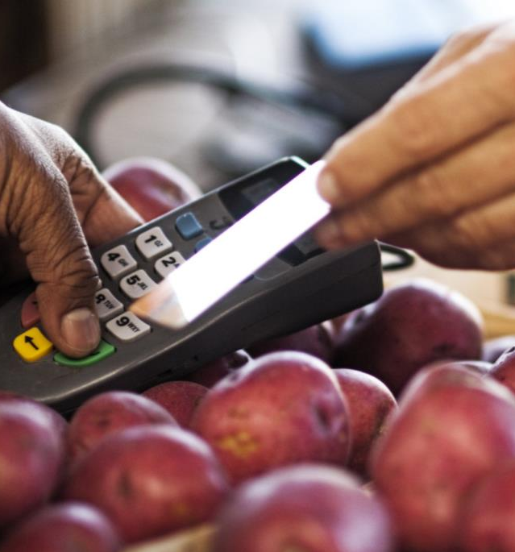
MICHIGAN GOOD FOOD FUND Eligibility: Assistance Programs
Alignment with Nutrition Assistance Programs
Projects must make good faith efforts to accept federal and state benefits or maximize federal food/nutrition programs, if relevant.

Slide 24
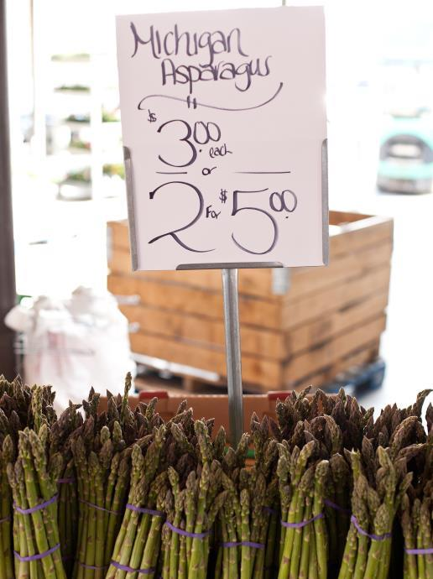
MICHIGAN GOOD FOOD FUND Eligibility: Mission Fit
Additional supportive evaluation criteria:
Healthy Food Access
Economic Development & Job Creation
Racial & Social Equity
Environmental Stewardship
Local Sourcing
Notes:
As mentioned, the Fund is mission-driven. What does this mean for projects we support? We’re also looking for companies that advance and align with these mission qualifiers around healthy food access; economic development and job creation; racial and social equity; environmental stewardship; and local sourcing.

Slide 25
MICHIGAN GOOD FOOD FUND Mission Fit
Healthy Food Access
The product uses fresh produce or uses whole, minimally processed ingredients.
The product is considered healthy.
The product is available in markets in/near low-medium income communities or donates proceeds or product to local food access cause.

Slide 26
MICHIGAN GOOD FOOD FUND Mission Fit
Economic Development
The business has potential to create quality jobs.
The business does or will offer career path for employees.
The business does or will offer training for employees.
Workers are treated fairly.
Notes:
Economic Development

Slide 27
MICHIGAN GOOD FOOD FUND Mission Fit
Racial & Social Equity
The business is owned/operated by a woman or person of color.
Women, people of color, and low-medium income residents have access to product.
The business employs women, people of color, or people from low-medium income communities.

Slide 28
MICHIGAN GOOD FOOD FUND Mission Fit
Environmental Stewardship
The business uses ingredients that are organic, sustainably-grown, and/or chemical-free.
The business has waste reduction strategies.

Slide 29
MICHIGAN GOOD FOOD FUND Mission Fit
Local Sourcing
The business uses Michigan grown/made ingredients.
The business utilizes local vendors for other business requirements.
Local products are branded and marketed as such.

Slide 30
LOAN NUTS & BOLTS

Slide 31
MICHIGAN GOOD FOOD FUND Loan Nuts & Bolts
Size Range | Up to $5 Million
Uses of Funds | Construction Acquisition Tenant Improvements Equipment Working Capital / Inventory Refinance
Loan Term | 3-10 years
Interest Rate | 5 - 6.5%, generally

Slide 32
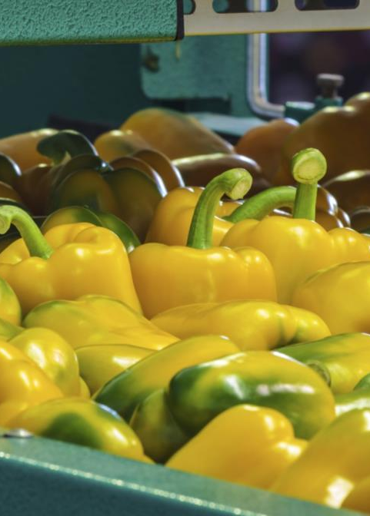
MICHIGAN GOOD FOOD FUND General Timeline for Financing
10-12 weeks, in general
Inquiry reviewed
Referral to CIP or Intermediary Lender
Triage – 1 week
Screening – 1 week
Underwriting -- 4 weeks
Closing – 4 weeks

Slide 33
MICHIGAN GOOD FOOD FUND General Business Benchmarks
Typically, we look for:
Three years of financial performance
Cash flow to service debt, in the range of 1.25 : 1.00
Collateral is expected, 90% loan to value max
Personal Guarantees from owners
Expectations are higher for less established businesses

Slide 34
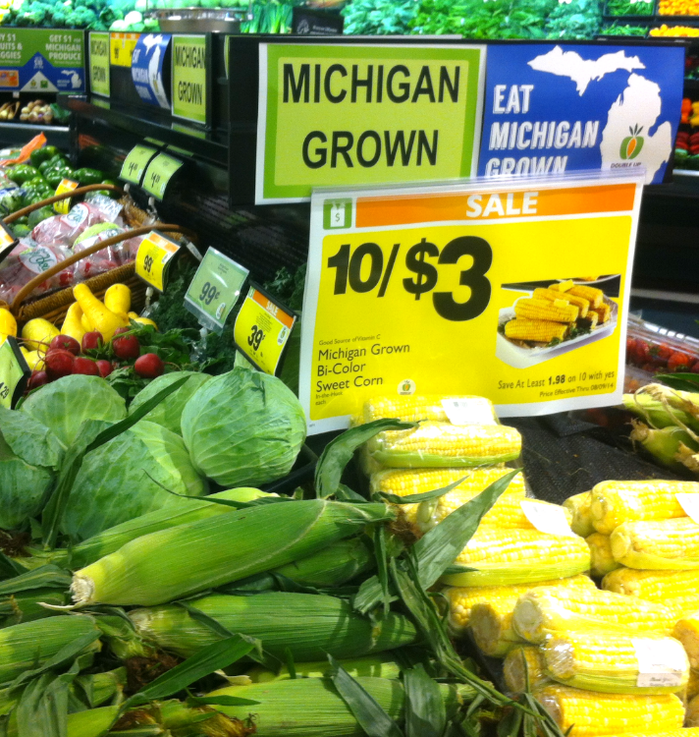
MICHIGAN GOOD FOOD FUND Sample Projects
Examples:
Established retailer looking for a 3rd location
Processor/manufacturer looking to expand to permanent site

Slide 35
CONNECT WITH THE FUND!

Slide 36
MICHIGAN GOOD FOOD FUND If you’re a…
Good Food Enterprise
Review Program Guidelines on Fund website.
Connect with us for financing and business assistance through the online Inquiry Form located here:
www.migoodfoodfund.org/submit
Notes:
We need your help spreading the word, especially around pipeline development

Slide 37
MICHIGAN GOOD FOOD FUND If you’re a…
Consultant
We’re building a Network of preferred consultants!
Consultants are needed with expertise in a variety of areas.
Email us: info@migoodfoodfund.org
Notes:
We need your help spreading the word, especially around pipeline development

Slide 38
MICHIGAN GOOD FOOD FUND If you’re a…
Intermediary Lender
We are seeking intermediary lenders to underwrite loans less than $250,000.
Capital is available (up to $500,000) for existing CDFIs or micro-lenders to participate in the Fund.
Email us: info@migoodfoodfund.org

Slide 39
DIG IN
www.MIGoodFoodFund.org
info@MIGoodFoodFund.org
Notes:
We need your help spreading the word! Join the fund on social media, sign up for email updates, email question to info@
THANKS!

